Slide 1
Creating Reports and Dashboards with Power BI
By Michael P. Antonovich
http://sharepointmike.wordpress.com
#Sharepointmikea

Slide 2
Please silence cell phones

Slide 3
My Published Books
User’s Guide to the Apple ][ - 1983
FoxPro 2 Programming Guide – 1992
Debugging and Maintaining FoxPro – 1992
Using Visual FoxPro 3.0 – 1995
Using Visual FoxPro 5.0 – 1996
Office and SharePoint User’s Guide – 2007
Office and SharePoint User’s Guide – 2010
Speaker at:
Code Camp Orlando
SharePoint Saturday Tampa & Orlando
SQL Saturday - #1, and over 30 others since then
IT PROCamp
PASS Summit 2012, 2013
Notes:
While this slide is up, ask everyone to introduce themselves to someone around them that they do not know.

Slide 4
Agenda
Show Reports pages using different built-in visualizations. Show switching from one visualization to another.
Show how to format visualization tables and charts.
Show how to add a Quick Calc Column in a table.
Show Condition Formatting.
Show Customizable Tooltips to display more data.
Create a Shape Map.
Show Table Styles.
Show Line Drilldown.
Show 3rd party visualizations web page: https://app.powerbi.com/visuals/
Show how to use a 3rd party visualization - Hierarchical Slicer
Show how to publish to PowerBI.com
Explain the different sharing models between PowerBI.com and Power BI desktop.
Show what PowerBI.com looks like - Open CONTOSO4 http://www.powerbi.com
Show how to add (pin) a visualization to a desktop
Create a new desktop.
Talk about printing reports and desktops.
Show how to publish your results to a website.
Show website: http://districtcollaboration.ocps.net/team/webservices/antonovich (Not open to public)
Show PowerBI Mobile App on iPhone
Start learning now at: https://powerbi.microsoft.com/en-us/guided-learning/

Slide 5
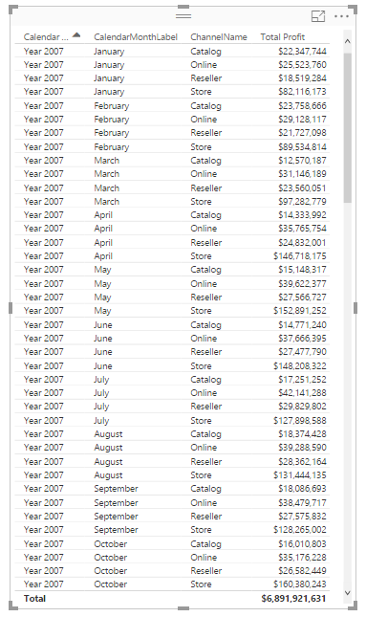
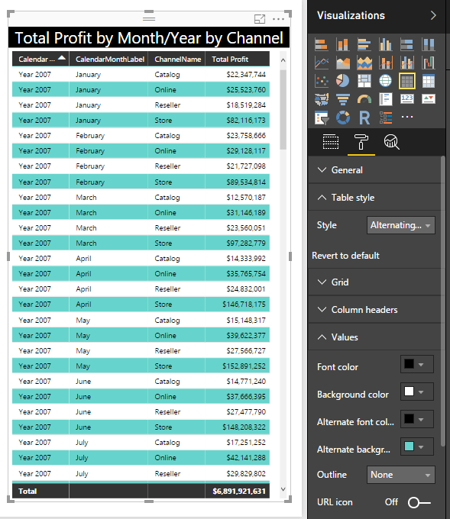
Visualizations like Tables have Formatting Options.
Each release of Power BI seems to add more formatting options to the visualizations.
Table styles provide a basic framework within which you can customize the colors, fonts, and line sizes further.
The table on the left was formatted with just a few options to appear as the table on the right. Some of the format options are also visible.

Slide 6
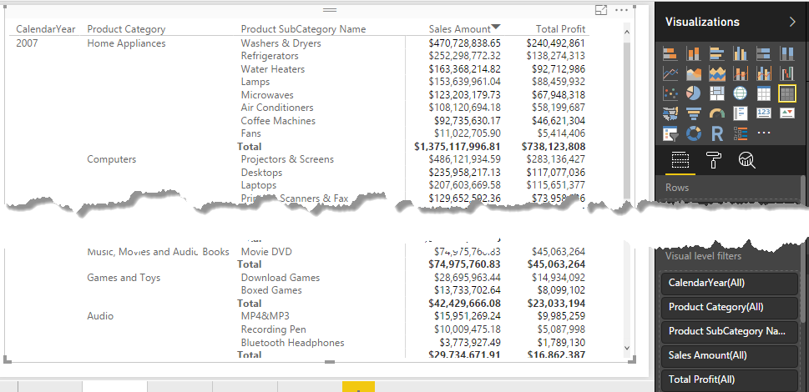
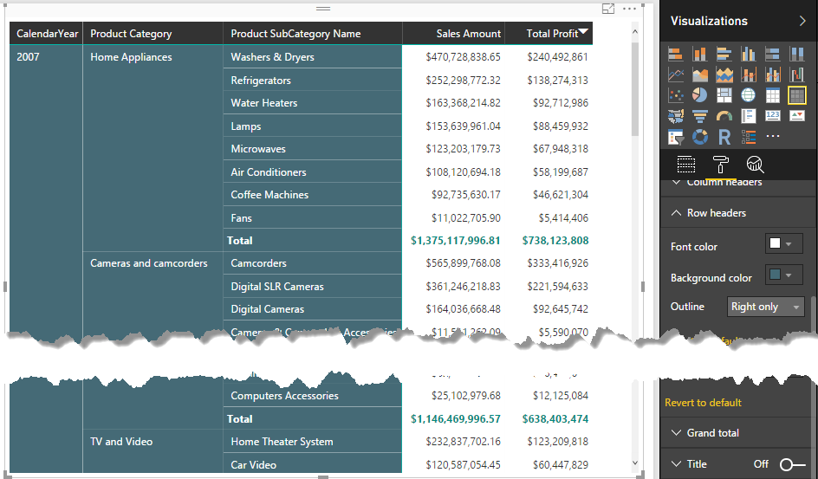
Matrix Tables also can be formatted using predefined styles that you can then customize further.
Part of creating a good report is formatting the data, tables and charts to make them attractive to the eye.
Try to stay in the same color family and font family at least within the same report page if not the entire set of reports for the dataset. (See themes in March 2017)

Slide 7
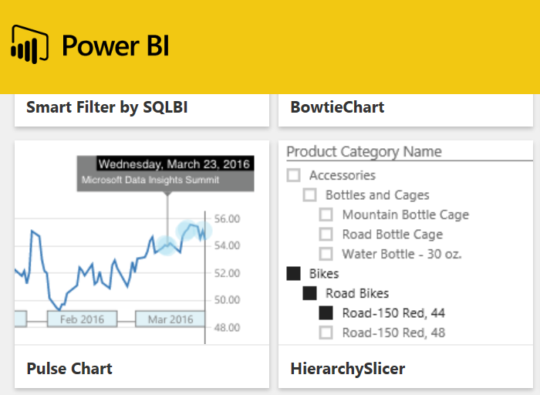
Custom Visualizations from 3rd Parties
You can download Power BI Visualizations at: https://app.powerbi.com/visuals/
Each month, you will usually find one or two new ones.
In this case, I want to use the Hierarchy Slicer.
You only have to download and install the visualization once on your machine and then you can use it in multiple reports.

Slide 8
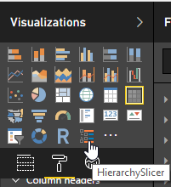
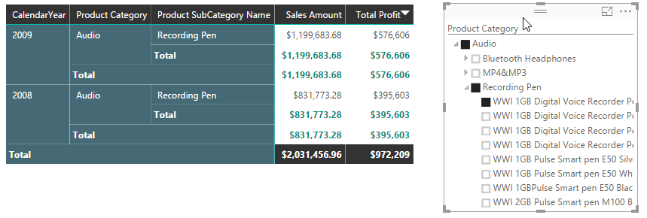
Adding and Using a 3rd Party Visualization To Power BI
You add a downloaded visualization by clicking on the ellipsis button in the bottom row of the Visualizations section
After it is added, it appears as an icon and can be added to any report by adding one or more fields to an empty area and then clicking the icon for the visualization.

Slide 9
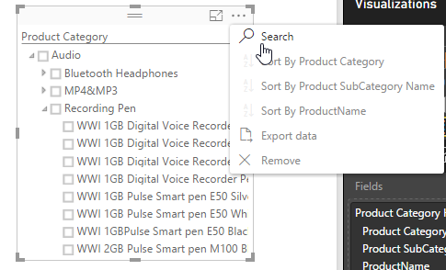
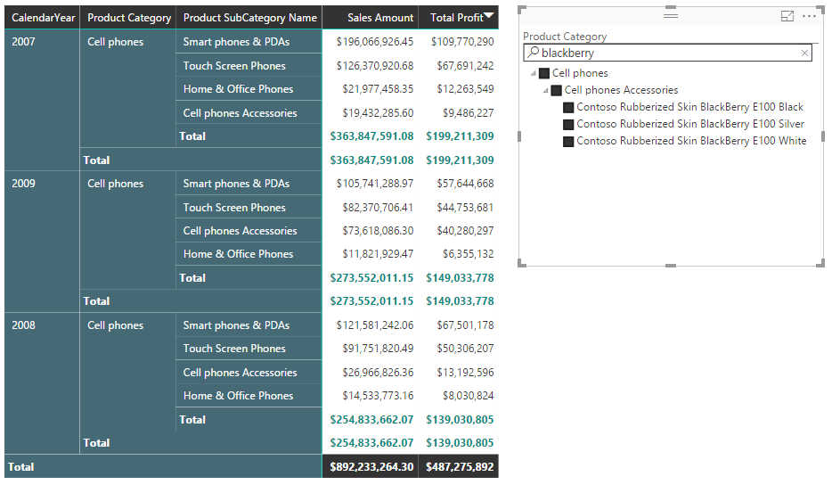
Use Search in the Hierarchy Slicer to find similar products for a report.
Use Search to find all the Blackberry phones.

Slide 10
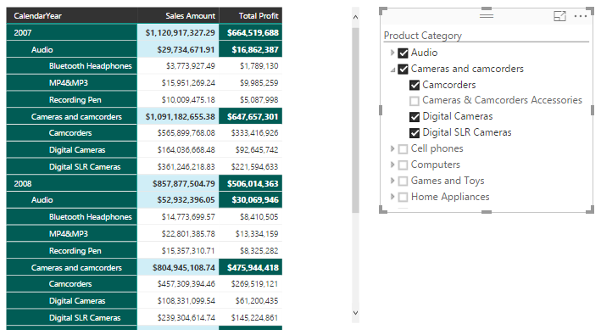
New Matrix Style (Beta)
There is a new matrix visualization that is currently in beta. It’s main advantage is the way it displays the hierarchy of row headers. Rather than use a separate column for each level, it uses an indentation. This will save you horizontal space and you can control the indentation through the properties. You can even revert to the old style.
Note: Totals are always in the header of each section.

Slide 11
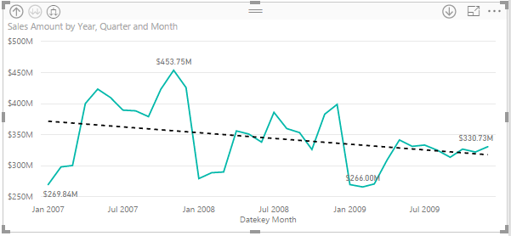
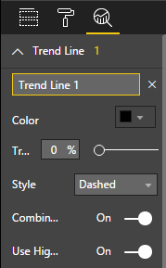
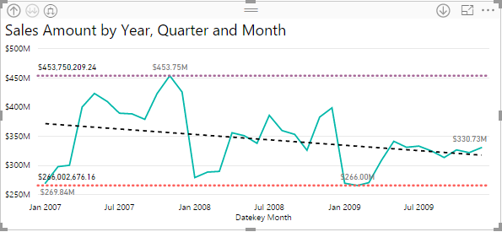
Use Data Analytics to Show Trends
The types of data analytics included are:
Trend Line
Average
Minimum
Maximum
Median

Slide 12
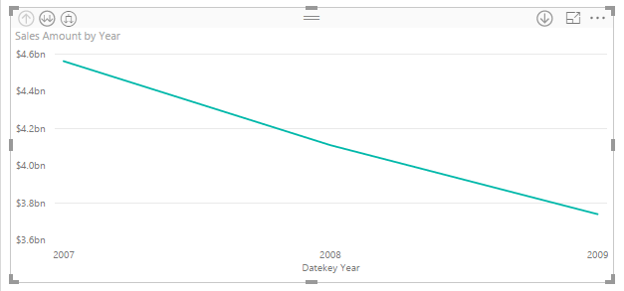

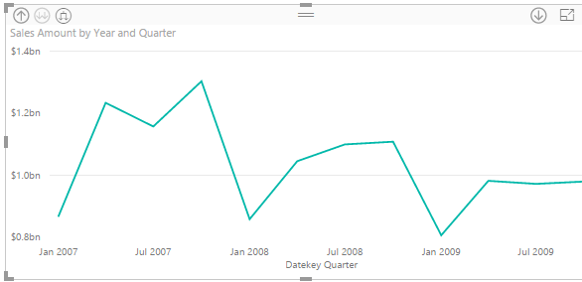
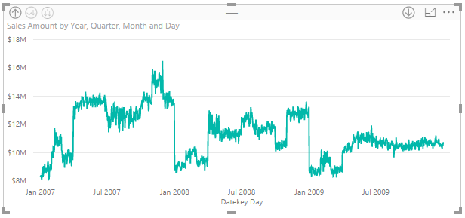
Drill Down Using a Timeline Chart
Drilldown works with a timeline chart or one with a hierarchy as the x-axis and allows you to move between different levels of aggregation with a simple click of the button.

Slide 13
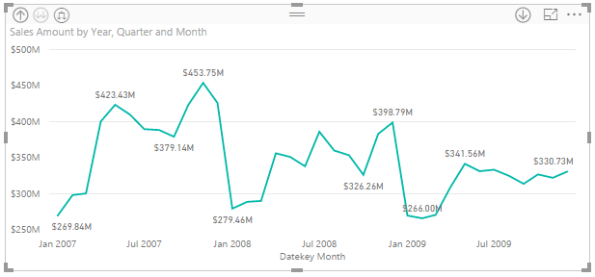
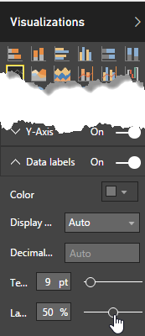
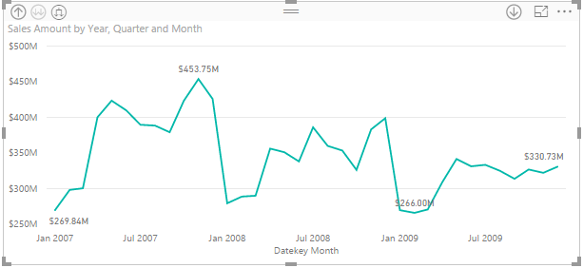
Label Density
Can you have too many labels on a chart?
Yes!
The Line visualization has an option called Label density which allows you to change how many labels are displayed. Just look at the two versions of the same chart on this page. One has 10 data point labels and the other only has 4 data point labels.
Note: Axis must have continuous values (numbers or dates), not categories.

Slide 14
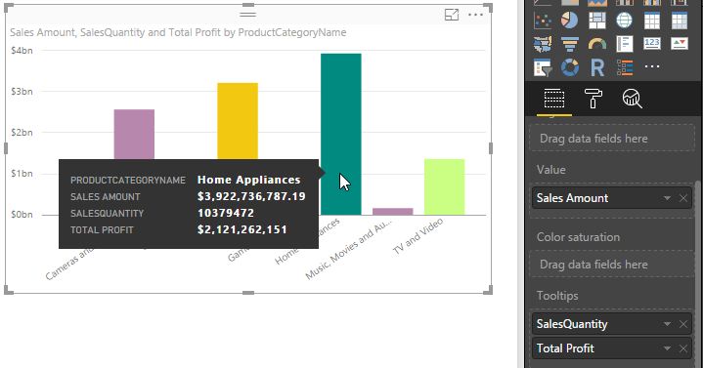
Add Measures to ToolTips
Tooltips originally displayed the data used to generate the chart.
Now you include any other numeric value and Power BI automatically calculates the sum of that factor. But you have other aggregate options as well

Slide 15

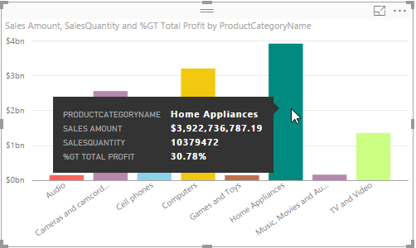
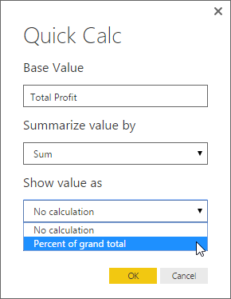
Quick Calc
One interesting quick calc you can perform for a tooltip property is a calculated measure of the Percent of Grand Total of the base field.

Slide 16
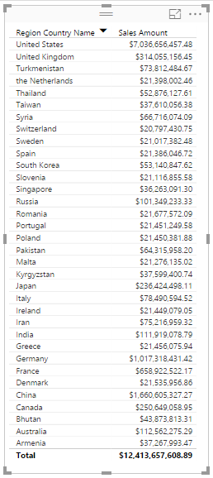
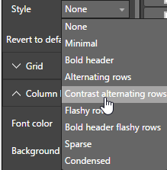
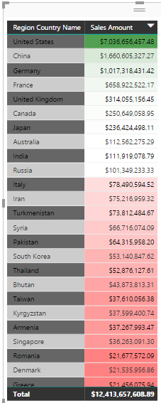
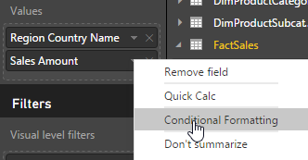
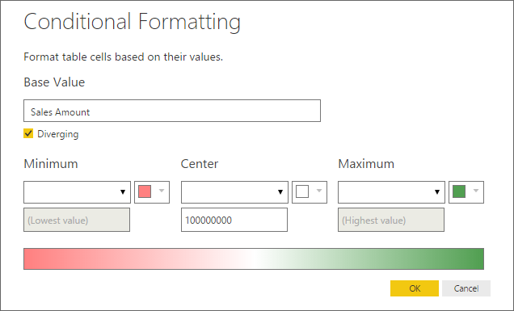
Combining Styles with Conditional Formatting

Slide 17
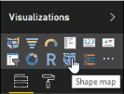
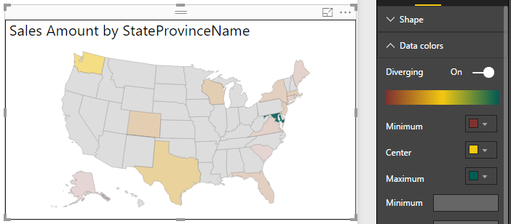
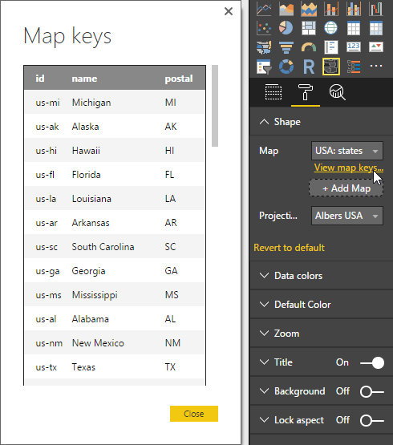
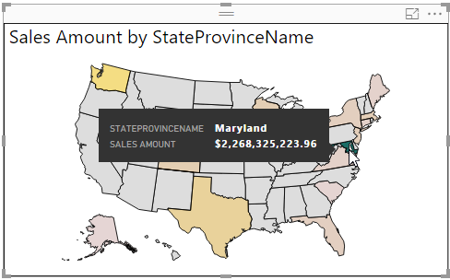
Using Shape Maps to Show Geographic Data

Slide 18

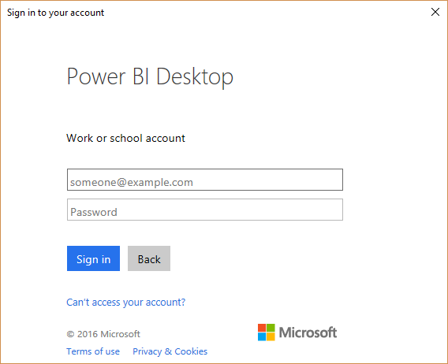
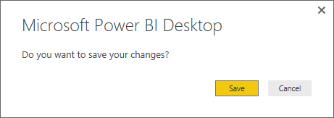
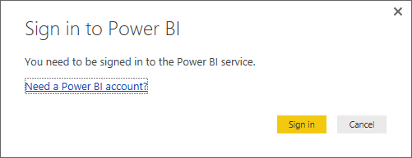
Publishing/Sharing Your Data
Select the Publish button from the ribbon.
Then follow the screens to log into your Power BI account.
Publishing can take several minutes depending on the size of your file

Slide 19
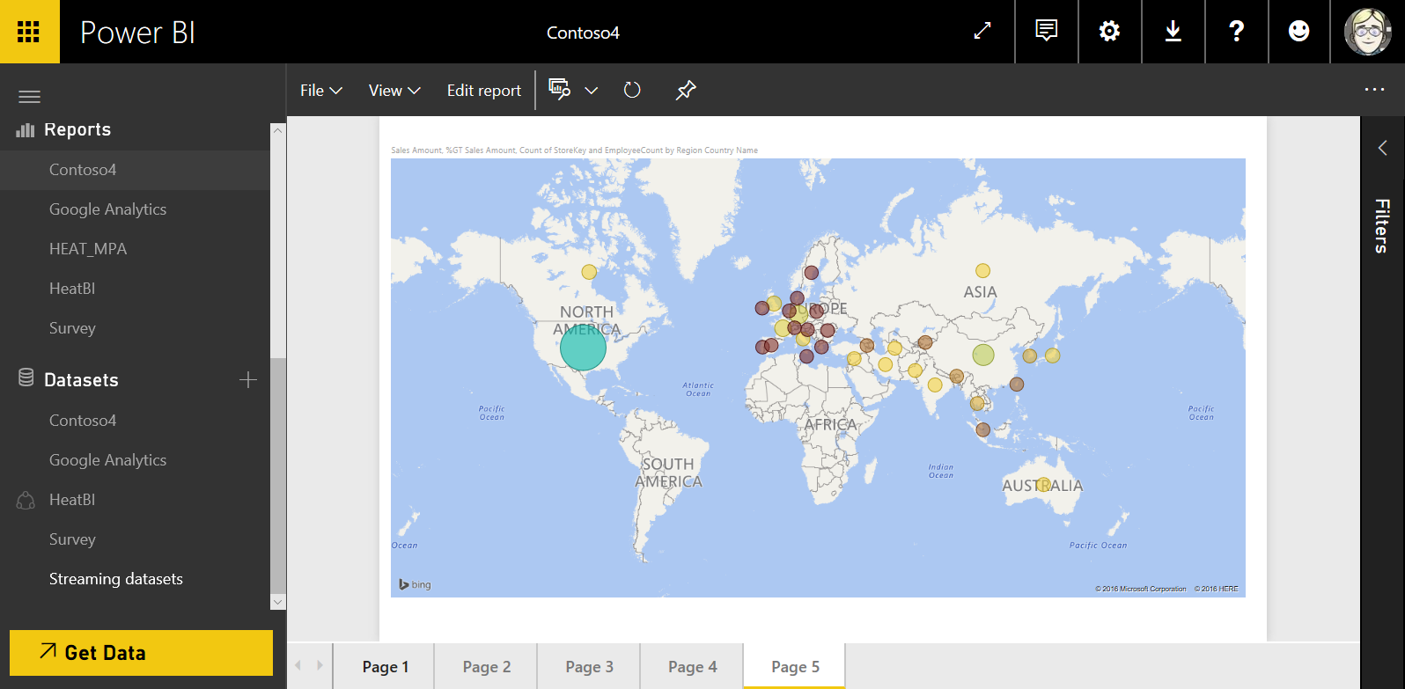
Example of Published Power BI Reports
Login into your account at: http://www.powerbi.com

Slide 20

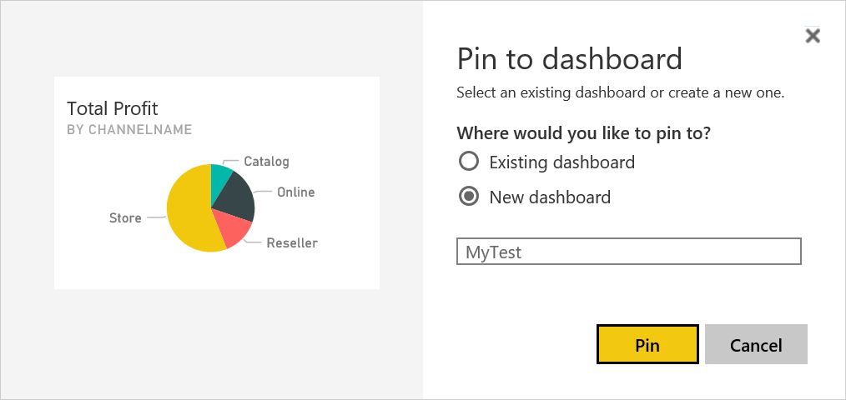
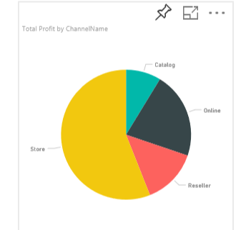
Pinning Report Elements to a Dashboard
Pin an entire report
You can pin a report or an individual data visualization to an existing dashboard by selecting the dashboard by name or you can create a new dashboard by entering a new dashboard name.
Pin individual visualizations

Slide 21
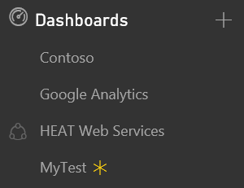
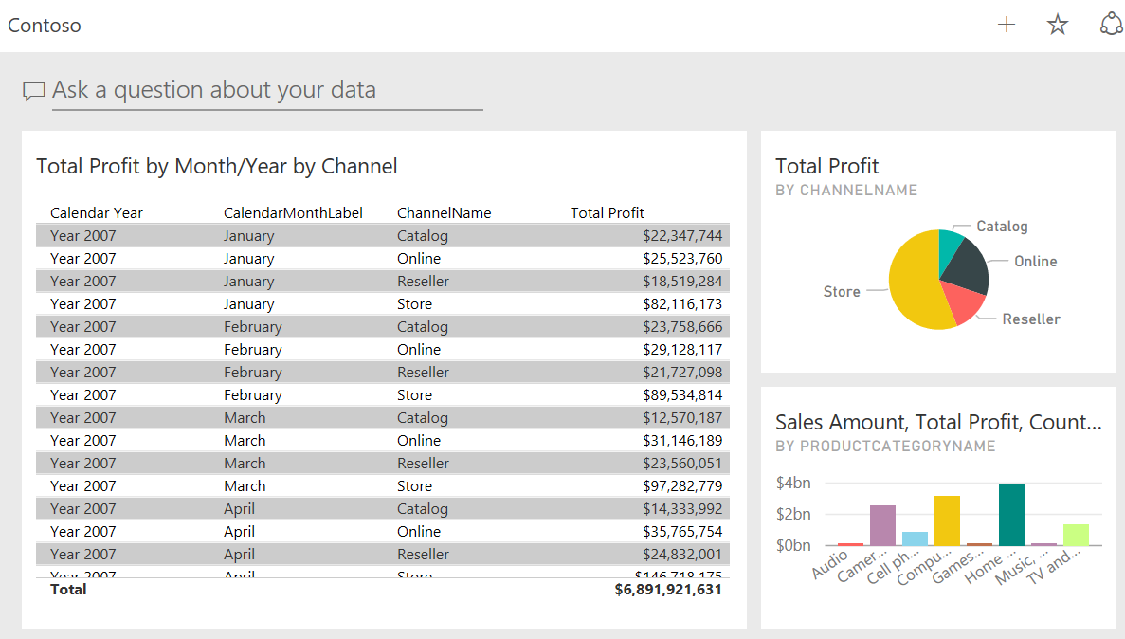
Viewing Dashboards
After pinning your visualizations to dashboards, you can open any one you want by clicking on its name.
The asterisk indicates a new dashboard

Slide 22
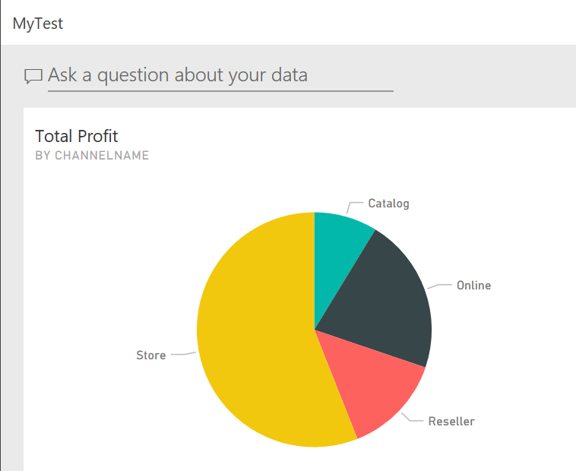
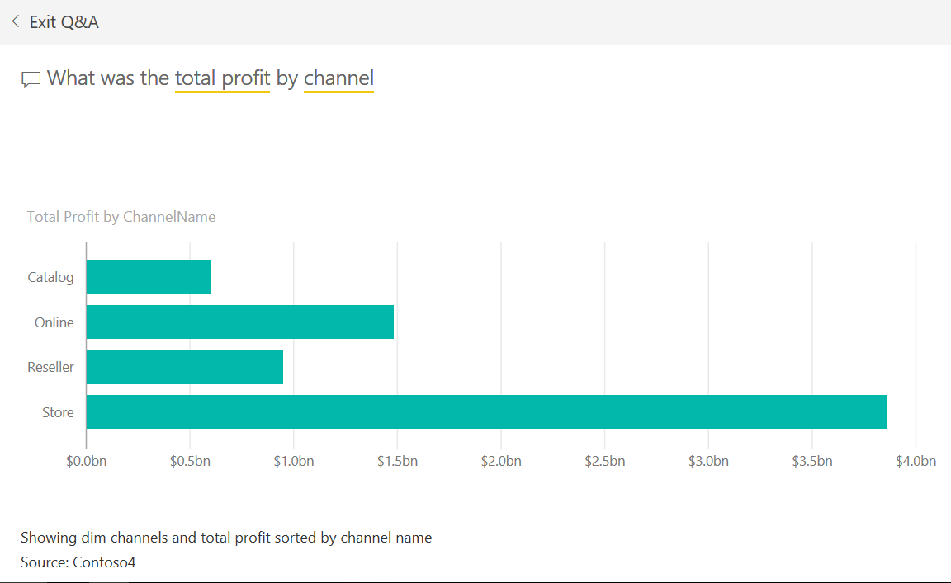
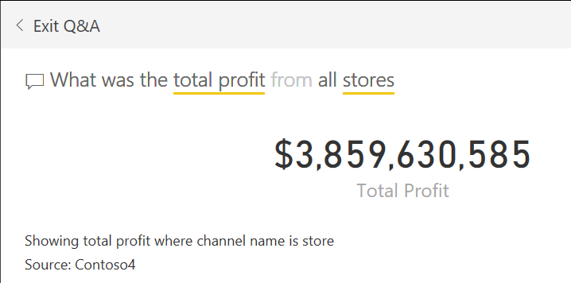
Querying the Data in your Dashboard
From the dashboard, you can ask questions about the data in the dashboard using English. Power Bi determines the best way to display your answer, numeric, table, or chart.

Slide 23
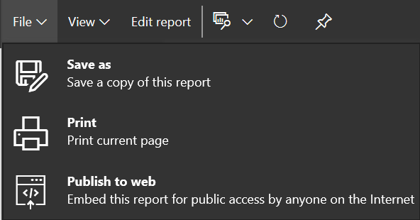
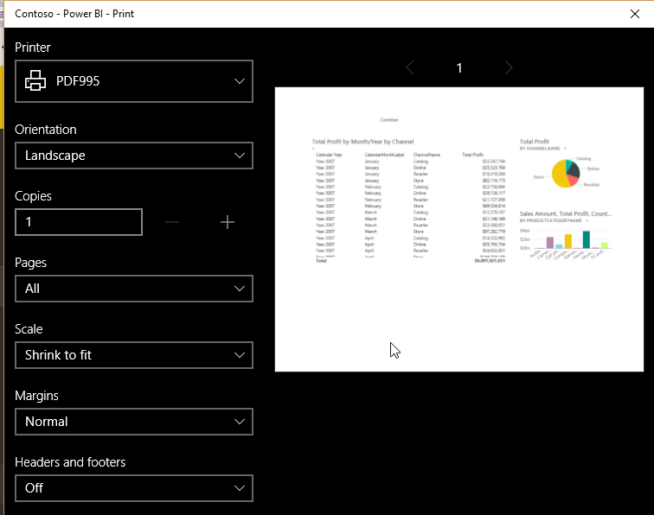
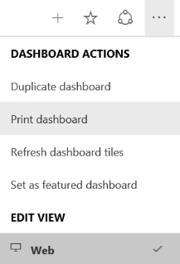
Print your Reports & Dashboards
Print Report
Print Dashboard

Slide 24
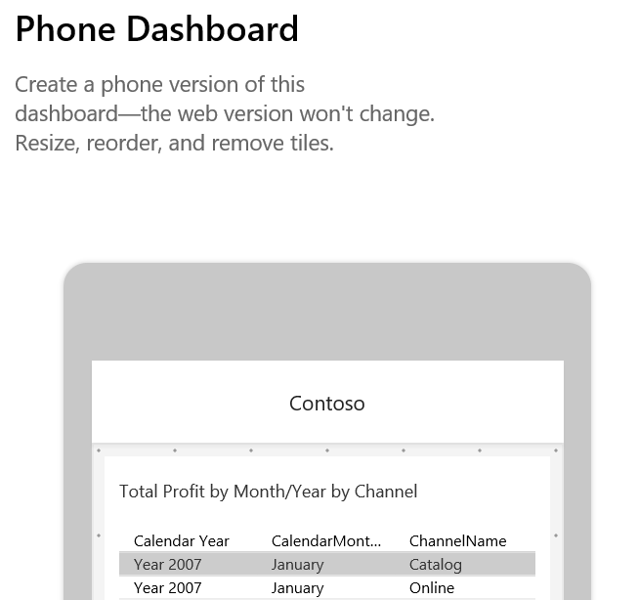
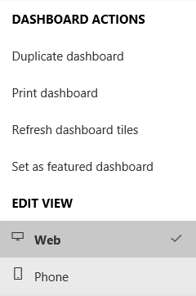
Check How the Dashboard Will Look on Your Phone
You don’t have to have or even open a smartphone to see how your dashboard looks on a this small screen format. All you need to do is select Phone from the Edit View options. You can resize, reorder and remove individual tiles from the phone view without affecting the web view.

Slide 25
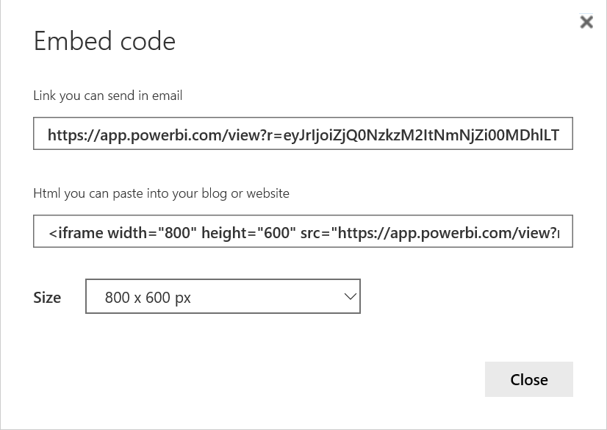
Get the Code to Publish Your Report to the Web
When you select: Publish to Web, a dialog provides a link you can use on a web page, not just in email, and the <iframe> code to embed the report in any web page.

Slide 26
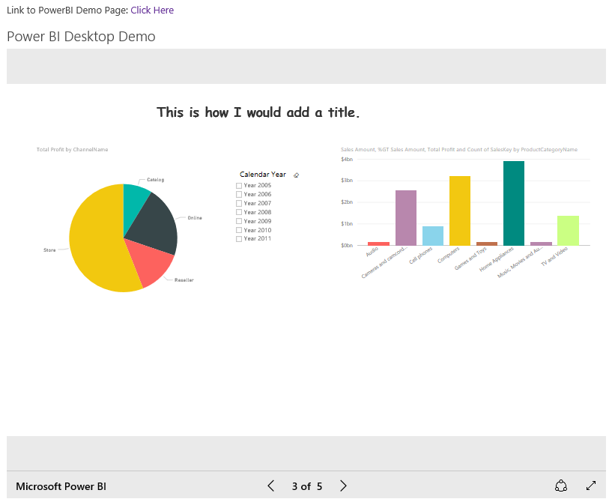

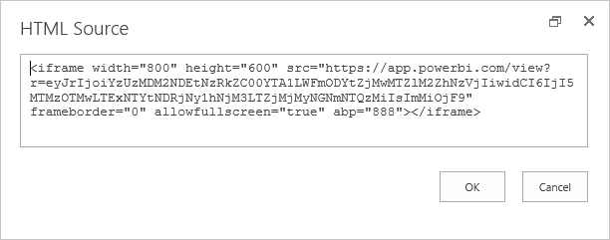
How Your Report Might Look on a Web Page
Add a simple hyperlink:
Or embed the code for the report
http://districtcollaboration.ocps.net/team/webservices

Slide 27
So How About Some Helpful Dashboard Guidelines
Guideline | Description
Start with the end | This is almost like creating a new program. What decisions will this dashboard attempt to answer and who within the organization needs to know.
How much interaction is needed? | Some users just want to see the results of the analysis. Others will want to drill down into the data.
Focus on one thing at a time | Use different dashboards to show how different categories affect a single measure and to show how a single category can affect different measures.
Formatting is Important | Be careful how you format numbers, the use of colors, additional text, titles.
Carefully select the visualization | While there are many different visualizations, some are better than others when trying to get your point across and not just chart the data.
Position Visualization based on importance | Because most people read top-down, left right, put your most important information and visualization on the upper left corner and spread right and down from there.
Decide what you are trying to show | Are you trying to show patterns/relationships, trends, comparisons or deviations, or outliers.

Slide 28

Questions
Contact Information:
Email: Mike_Antonovich@hotmail.com
Blog: http://SharePointMike.WordPress.com
Twitter: @SharePointMikeA
Linkedin: http://www.linkedin.com/in/michaelpantonovich

Slide 29

… for attending the 2017 Code Camp in Orlando, FL.

